Slide 1
Let’s consider a 35wt% Ni – 65wt% Cu alloy at three temperatures: (a) 1300 C, (b) 1250 C, and (c) 1190 C
Identify for each temperature:
Phases Present
Composition of each phase present
Fraction of each phase present

Slide 2
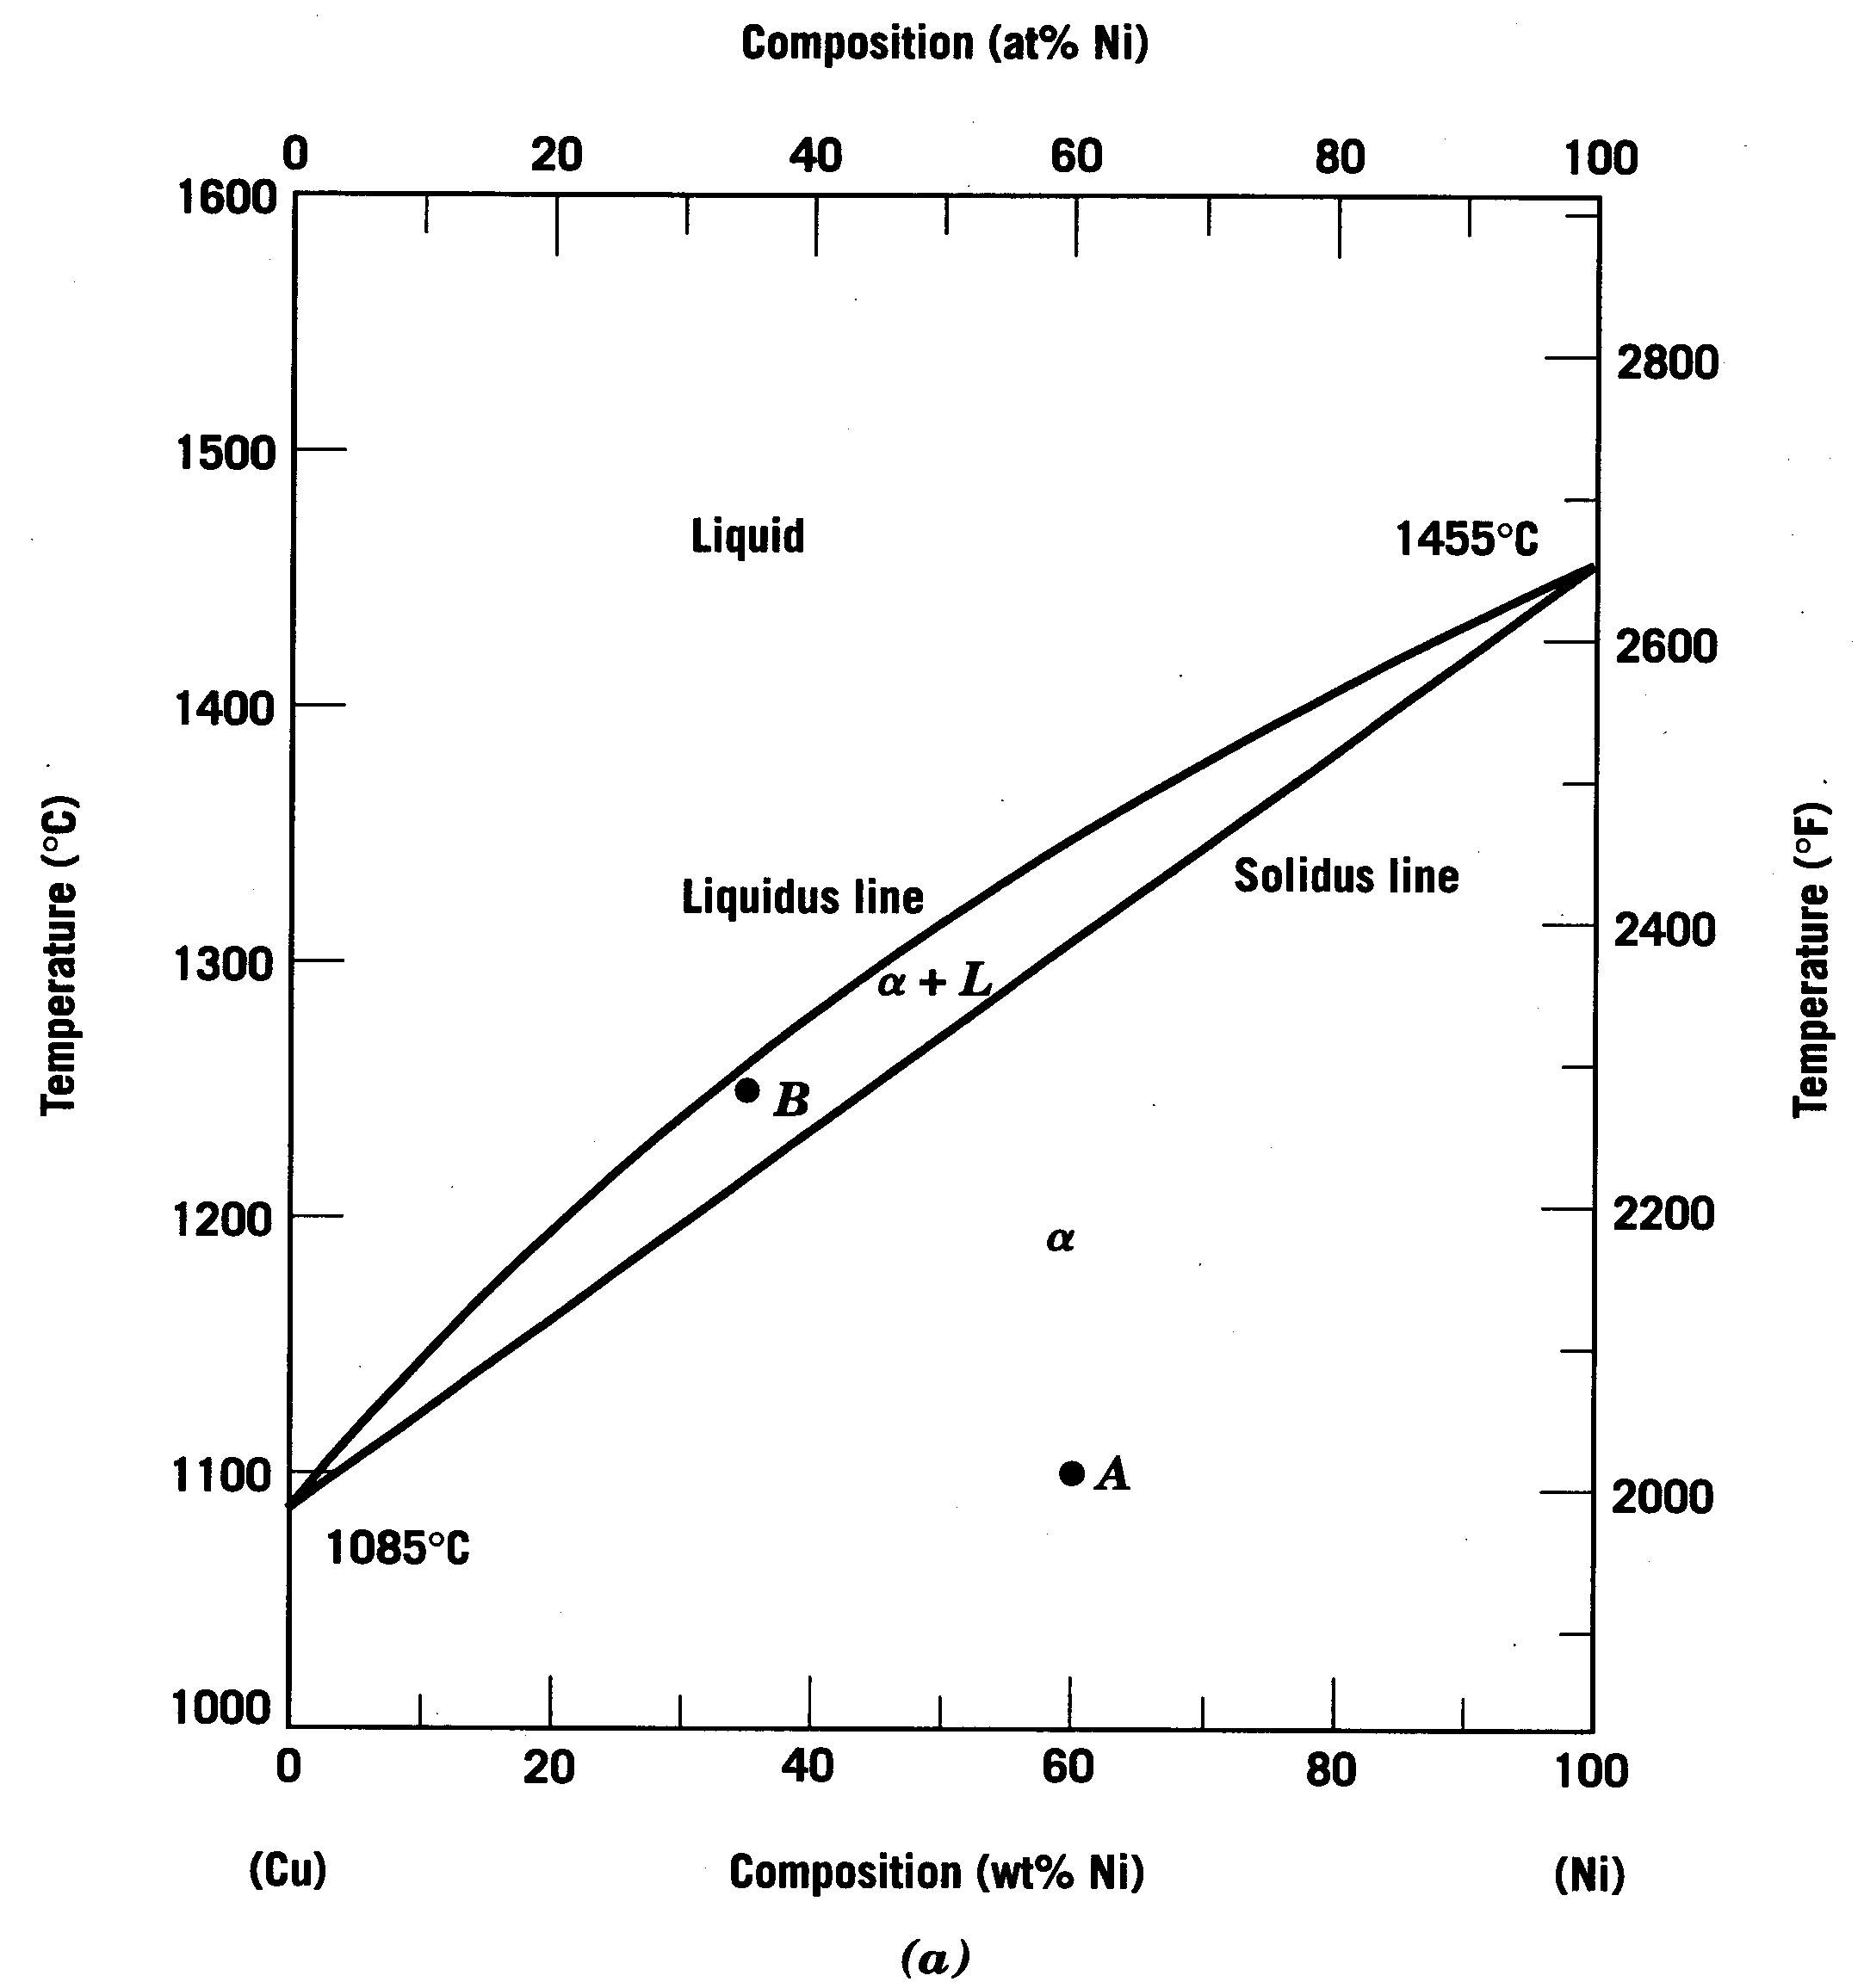
Consider: Cu-Ni phase diagram
Example of a Binary Isomorphous Phase Diagram
Let’s look at this region

Slide 3
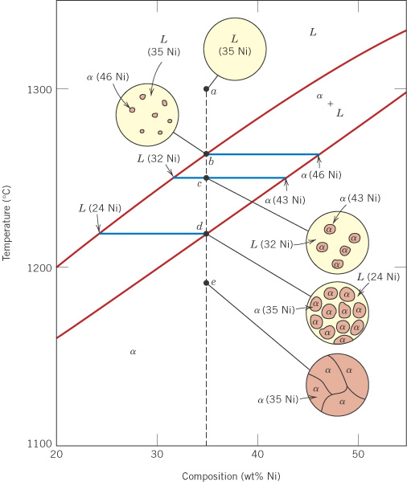
c10f04
Consider a 35wt% Ni alloy
1300°C
Components: Cu and Ni.
1. Phases present for 35% Ni at various temperatures:
At 1300°C (a) there is one phase: liquid solution, L.
At 1250°C (c) there are two phases: (1) solid solution α, (2) liquid solution L.
At 1190°C (e) there is one phase: solid solution, α.
1250°C
1190°C
 Cu
Ni 

Slide 4
c10f04
2. Phase compositions
At (a) 100% liquid solution, L
At (c), for the two phases, from the tie line:
(1) L is 32% Ni
(2) α is 43% Ni
At (e) 100% solid solution, α
1260°C
1220°C
Also:
At 1260°C (b) the first solid phase α forms.
At 1220°C (d) the last remaining liquid solidifies.
 Cu
Ni 

Slide 5
c10f04
3. Mass (weight) fractions
At (a) and (b): W_{L} = 1.00
At (d) and (e): W_{α} = 1.00
At (c), for the two phases,
L (32% Ni) and α (43% Ni):
R
S
L
32
(c)
35
α
43
%Ni
 Cu
Ni 

Slide 6
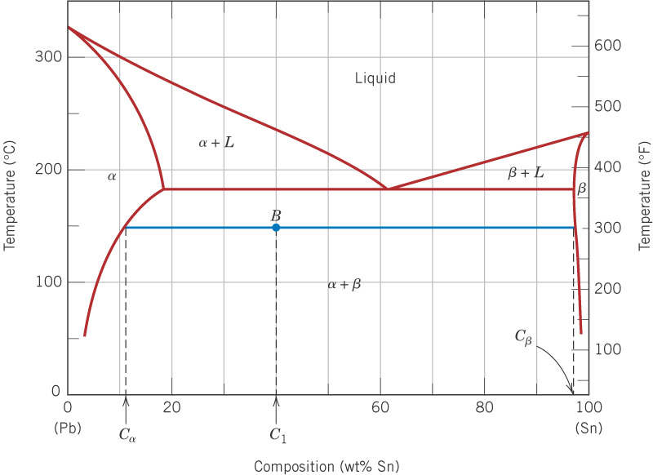
c10f09
Solubility
limits
150°C
11
40
98
Pb
Sn
At 150°C, what is:
(a) the maximum wt% solubility of Sn in Pb?
(b) the maximum wt% solubility of Pb in Sn?
Ans: 11% Sn
Ans: 2% Pb

Slide 7
c10f09
Examples 9.2 and 9.3(a)
For 40 wt% Sn - 60 wt% Pb
at 150°C, find:
Phases present:
(1) α is Pb-rich SS
(2) β is Sn-rich SS
150°C
11
98
Phase compositions, wt%:
α has 11% Sn, 89% Pb
β has 98% Sn, 2% Pb
40
R
S
Pb
Sn
Weight (mass) fractions:

Slide 8
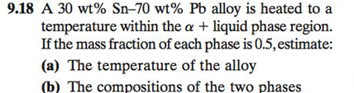
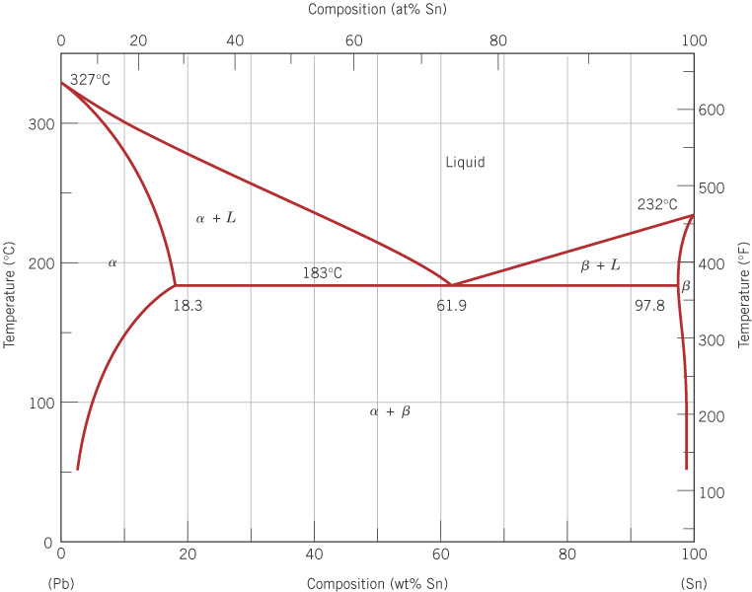

Slide 9
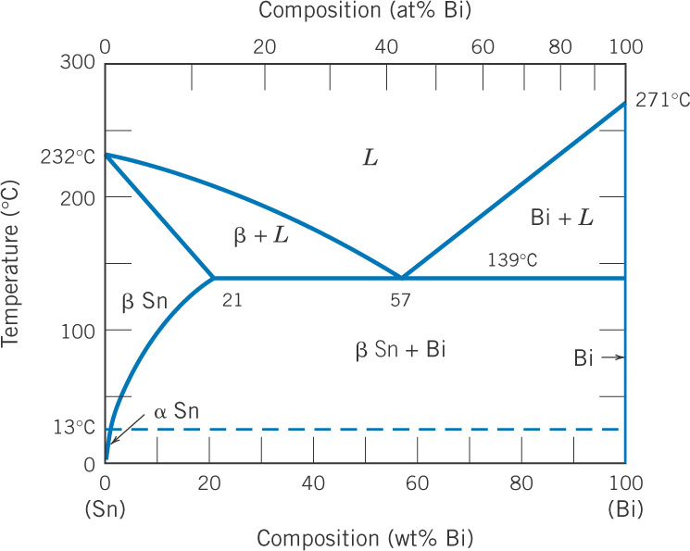
c10f10
Sn-Bi phase diagram
57 wt% Bi - 43 wt% Sn
is useful as a Pb-free
solder.
Why this composition?
What’s going on here?
Bi has some solubility in Sn.
But the solubility of Sn in Bi
is essentially 0% at all
temperatures.

Slide 10
c10f08
Pb-Sn phase diagram – Let’s take a look at microstructure

Slide 11
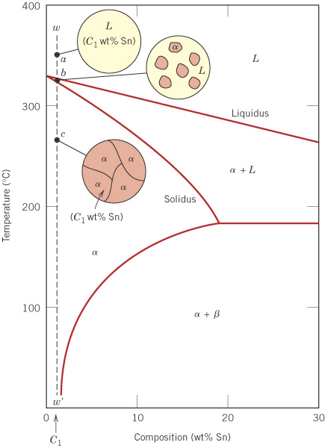
c10f11
Pb-Sn - single phase case
For a sufficiently small wt% Sn,
the solubility limit will never be
exceeded, so that a single phase alloy results.
Pb

Slide 12
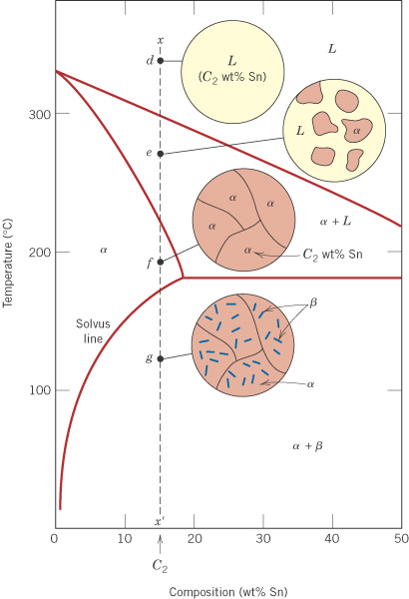
c10f12
Pb-Sn - simple
two-phase case
(no eutectic)
For larger wt% Sn, the solubility limit is exceeded on cooling, so that a two-phase material results.
Pb

Slide 13
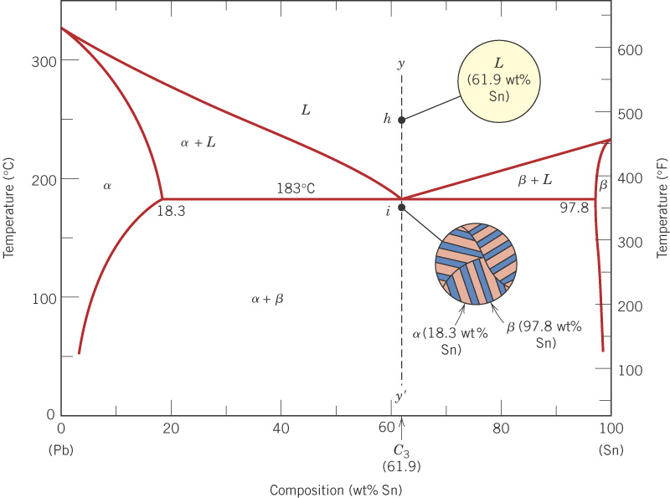
c10f13
Pb-Sn eutectic
For 61.9 wt% Sn, a layered eutectic structure is formed.
eutectic point
A
B
A-B is the eutectic line

Slide 14

c10f14
Pb-Sn eutectic
The dark areas are Pb-rich α solid solution, and the light areas are Sn-rich β solid solution.
375X

Slide 15
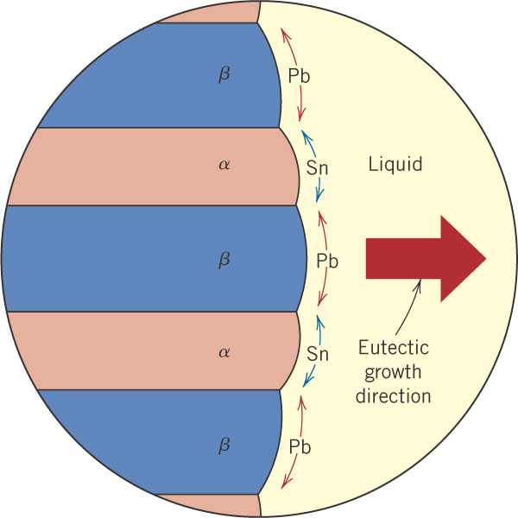
c10f15
Formation of the eutectic structure

Slide 16
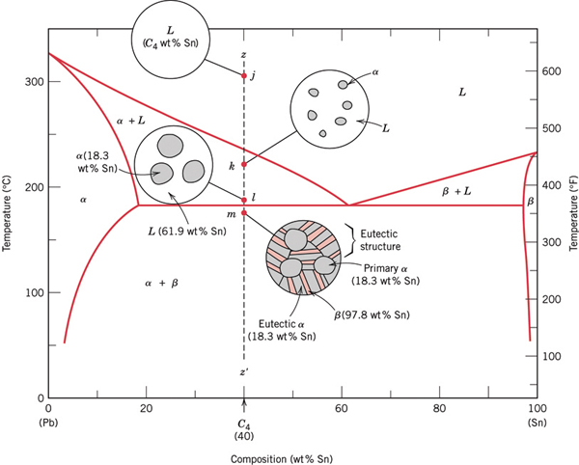
If the eutectic line is crossed, some eutectic structure will occur, but there will also be primary α or primary β if the composition is not at the eutectic point.
Pb-Sn eutectic
plus primary α

Slide 17
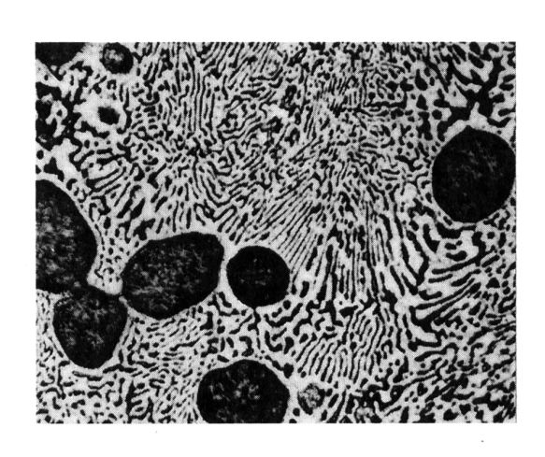
Pb-Sn eutectic
plus primary α
The dark areas are Pb-rich α solid solution, and the light areas are Sn-rich β solid solution.
400X

Slide 18
Calculation of fractions of alpha & beta in final microstructure

Slide 19
The End

